Slide 1
Lecture # 2
CSC336 Web Technologies
Credit Hours: 3(2, 1)

Slide 2


“Categories of Web Applications and Web
Architectures”

Slide 3
Introduction
Overview of web applications and architectures
Web applications use different structures to work efficiently and meet various needs. These structures, or architectures, help decide how the application is built, how it performs, and how well it can grow or handle complex tasks.
Importance of understanding different categories and architectural patterns
Understanding different categories and architectural patterns is crucial for designing effective, scalable, and user-friendly web applications tailored to specific needs and constraints.

Slide 4











Categories of Web Applications
Document- Centric
Social Web
Semantic Web

Slide 5


Document-Centric Web Applications
Focus on creating, managing, and sharing documents
Examples: Google Docs, Microsoft Office Online, Dropbox Paper

Slide 6


Features of Document-Centric Apps
Real-time collaboration
Version control
Document sharing
Editing tools

Slide 7
Social Web Applications
Platforms for user interaction and content sharing
Examples: Facebook, Twitter, Instagram, LinkedIn

Slide 8
Features of Social Web Apps
User profiles
News feeds
Social interactions (likes, comments, shares)
Notifications

Slide 9
Semantic Web Applications
Uses data with semantic meaning to enhance user experience Examples of semantic web applications include:
Wolfram Alpha: Provides answers to queries based on structured data and computational algorithms.
Google Knowledge Graph: Enhances search results with contextual information about entities.
Schema.org: Facilitates the use of structured data to improve search engine understanding of web content.

Slide 10
Features of Semantic Web Apps
ENHANCED SEARCH
CAPABILITIES
DATA INTEGRATION
CONTEXT-AWARE INFORMATION RETRIEVAL
IMPROVED DATA
RELATIONSHIPS

Slide 11
Web Architectures Overview
Introduction to architectural patterns:
Layered Architecture
One-Tier
Two-Tier
Three-Tier
N-Layered Architecture

Slide 12
Layered Architecture
Structure: Presentation Layer, Business Logic Layer, Data Layer
Benefits: Separation of concerns, modularity, scalability
Separation of concerns involves dividing a system into distinct sections, each handling a specific aspect of functionality;
modularity allows for independent development and maintenance of these sections
Scalability ensures that the system can handle increased loads or complexity effectively.

Slide 13
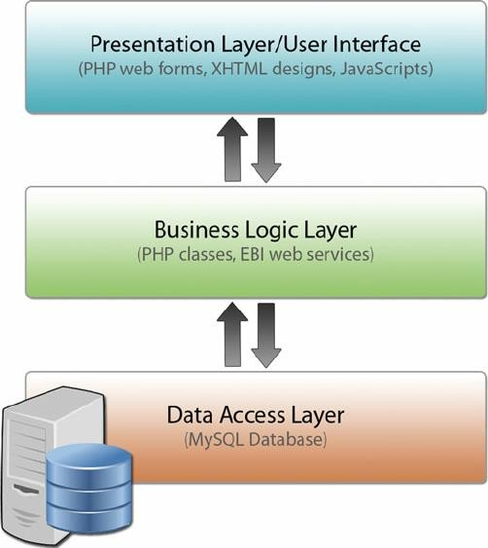
Diagram of Layered Architecture

Slide 14
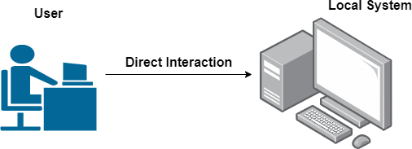
One-Tier Architecture
Also known as Single-Tier
All components integrated into a single system
Examples: Desktop applications or simple applications

Slide 15
Two-Tier(C-S) Architecture
Structure: Client-Server
Client handles presentation; server manages data
Examples: Basic client-server applications, such as online forms

Slide 16
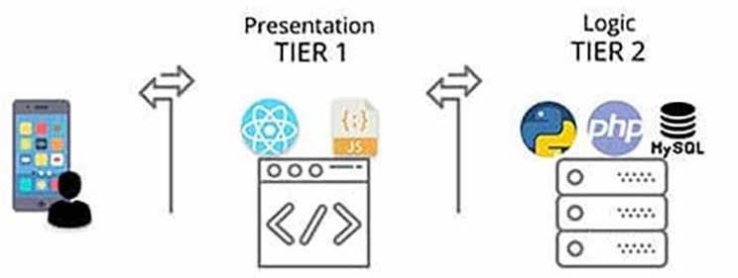
Diagram of Two-Tier Architecture
Visual representation of Client and Server layers

Slide 17
Three-Tier Architecture
Structure: Presentation Tier, Application Tier, Data Tier
Benefits: Improved scalability, separation of concerns, easier maintenance

Slide 18
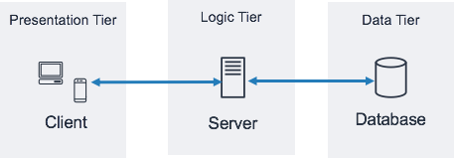
Diagram of Three-Tier Architecture
Visual representation of Presentation, Application, and Data Tiers

Slide 19
N-Layered Architecture
Extension of layered architecture with multiple layers:
Presentation
Application
Domain
Data Access
Benefits: Flexibility, modularity, scalability, maintainability

Slide 20
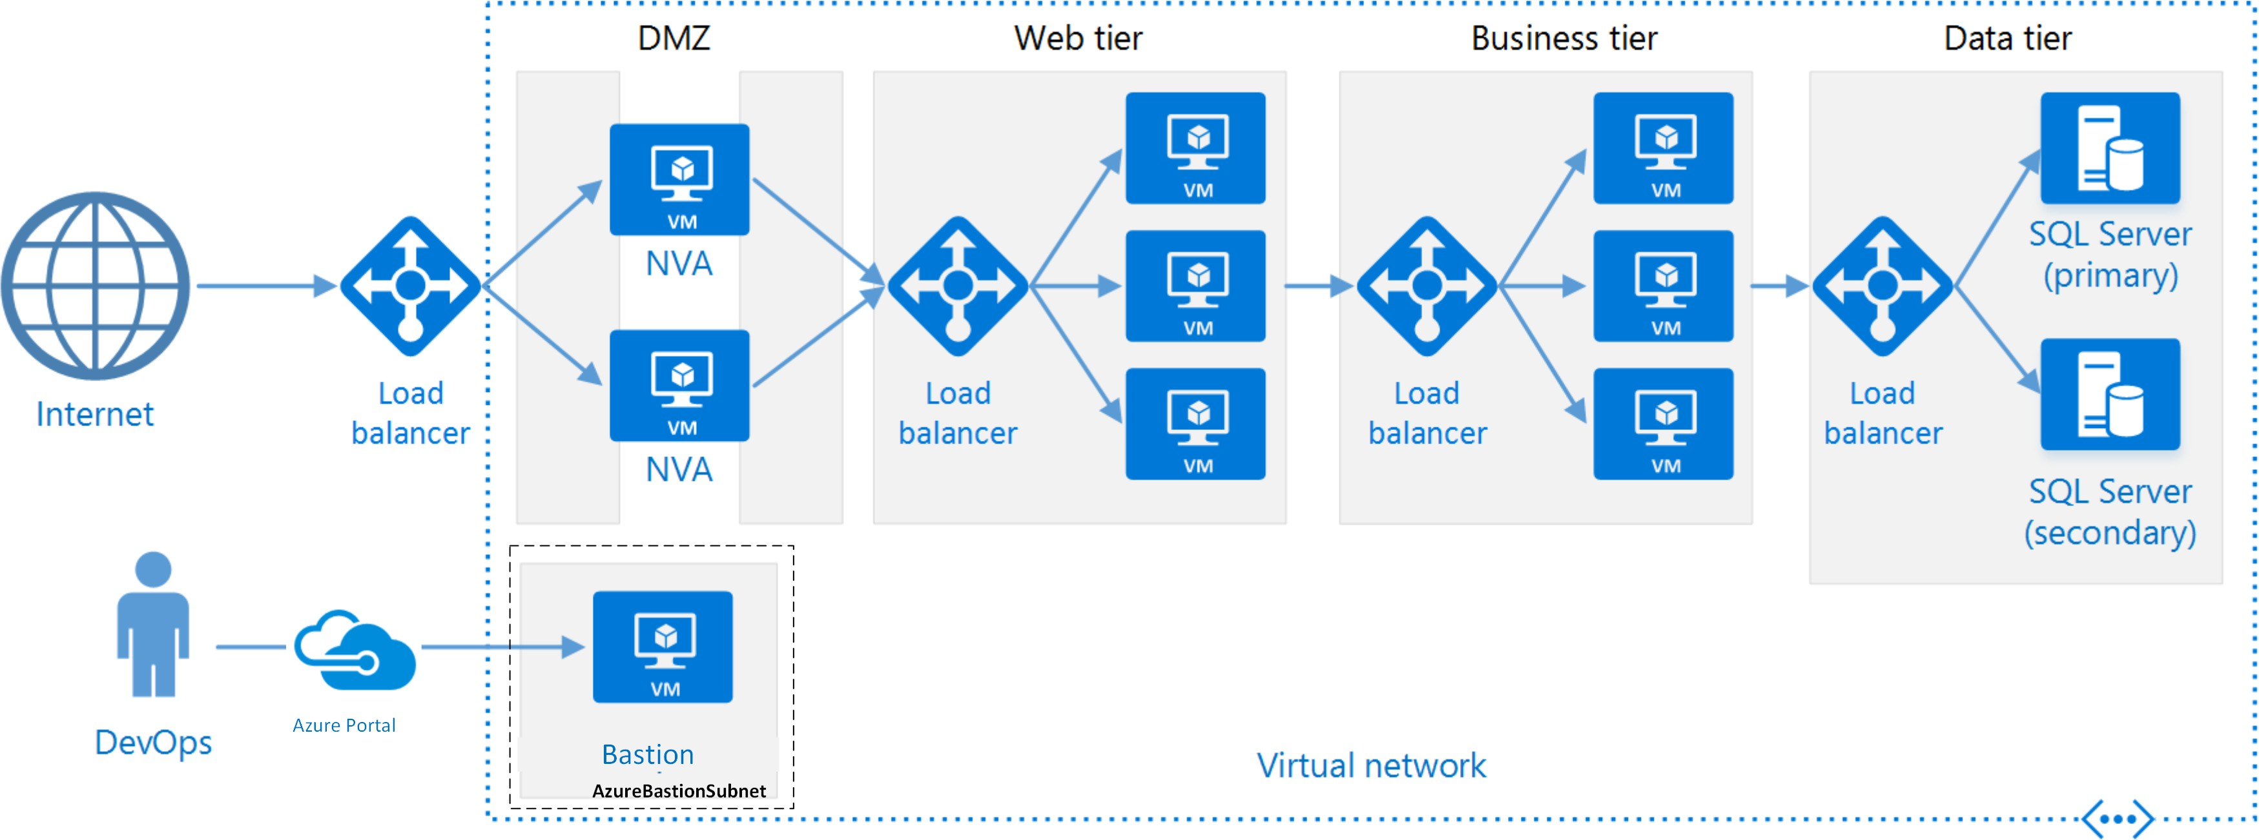
Diagram of N-Layered Architecture
Visual representation of multiple layers and their interactions

